Slide 1
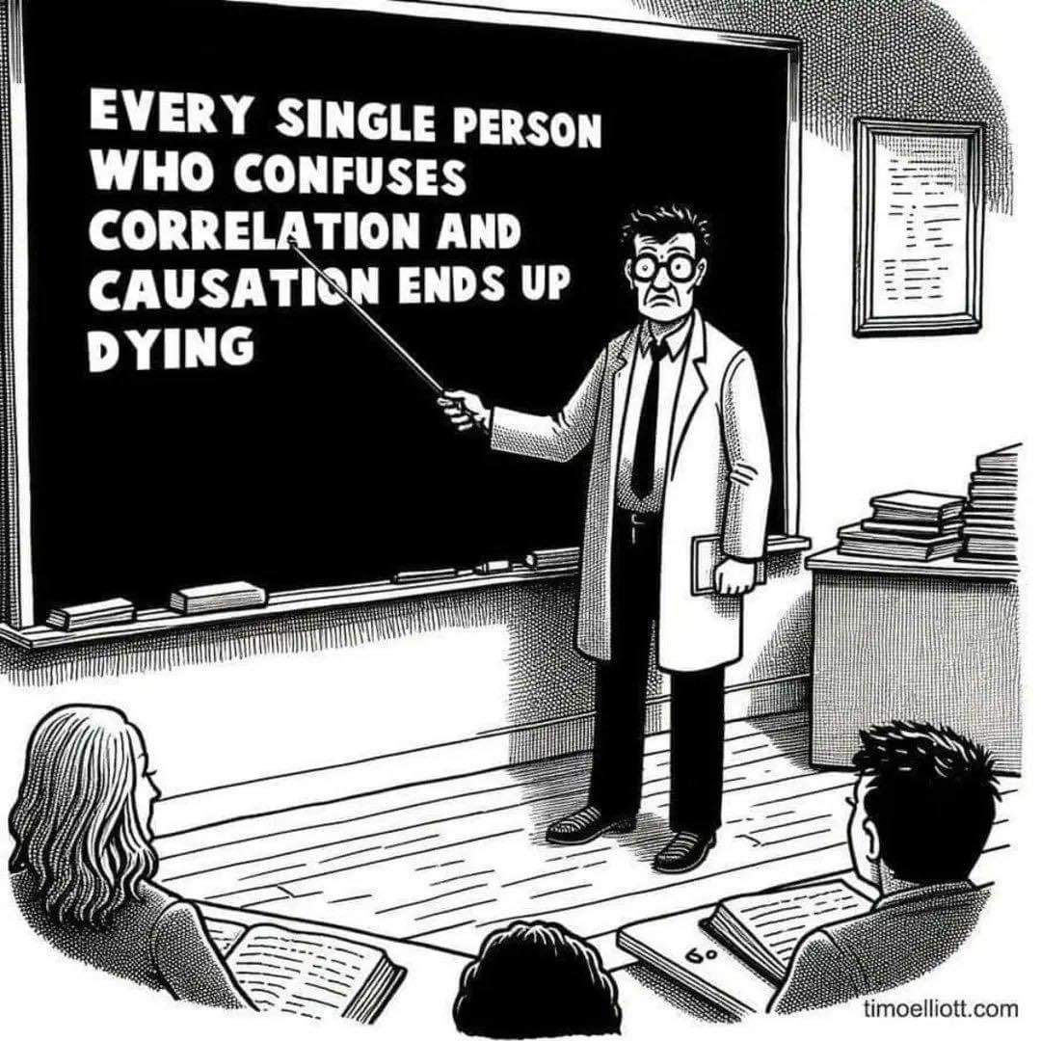
Causal Approaches to Observational Data

Slide 2
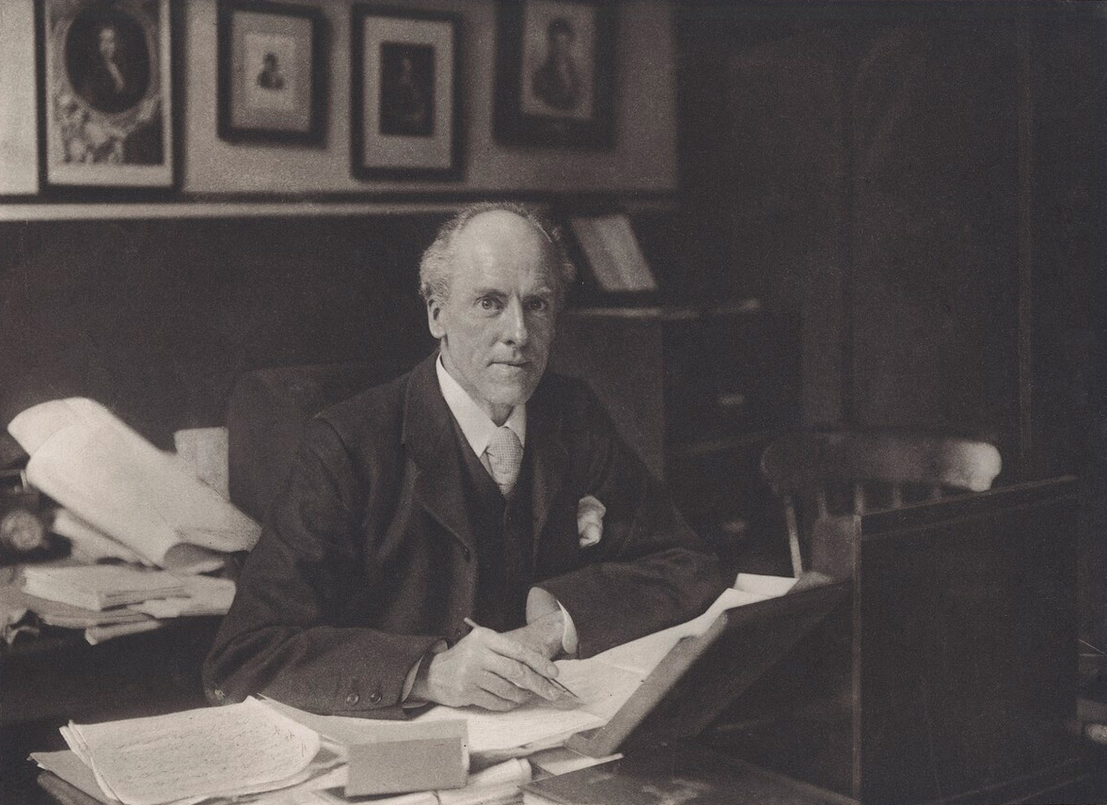
Correlation does not imply Causation

Slide 3
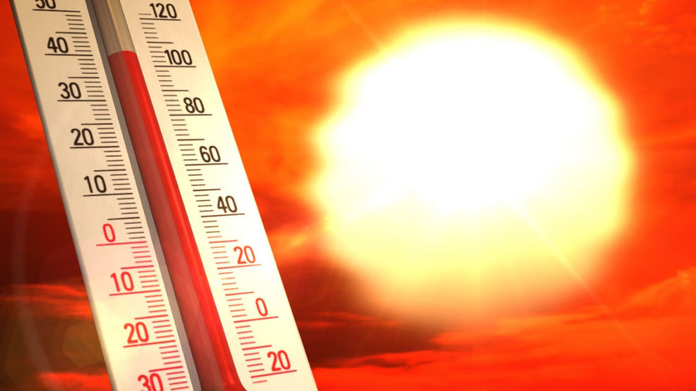
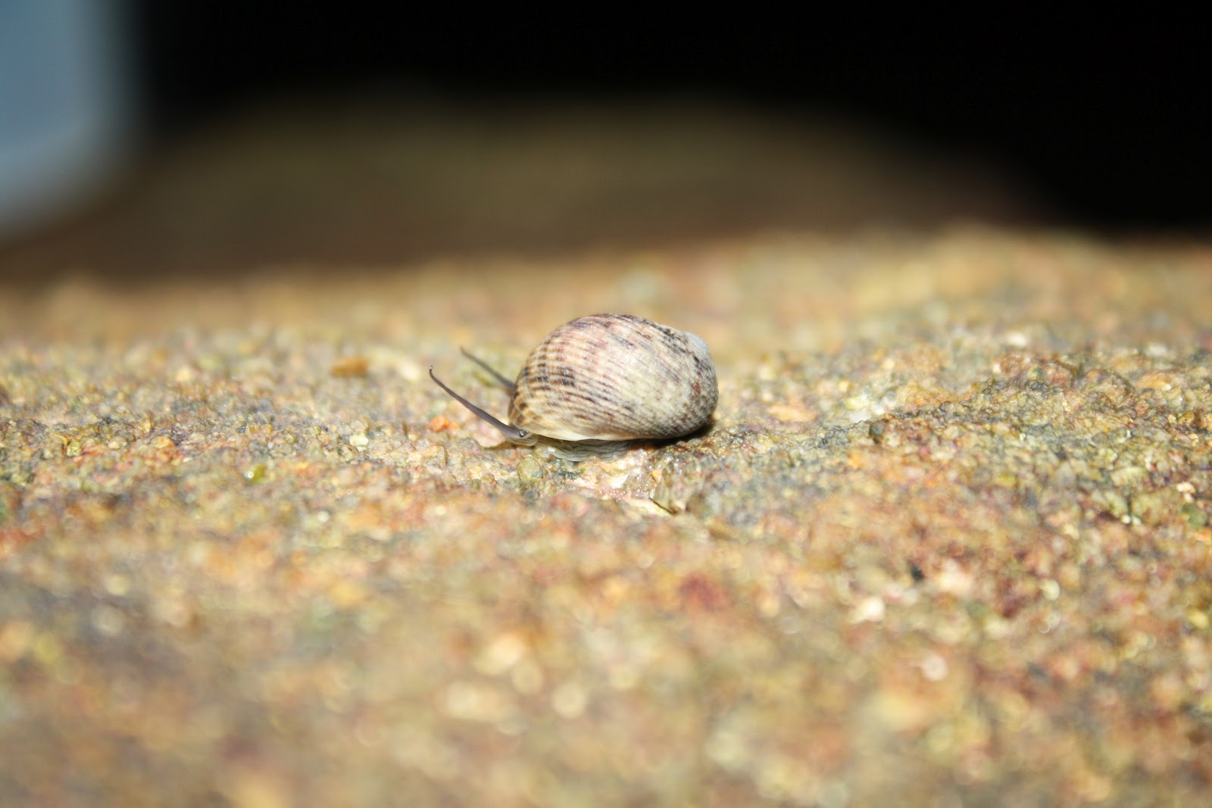
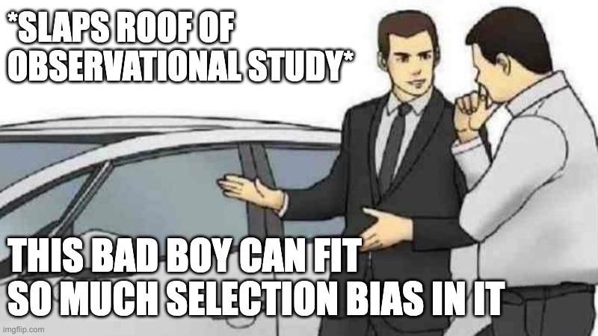
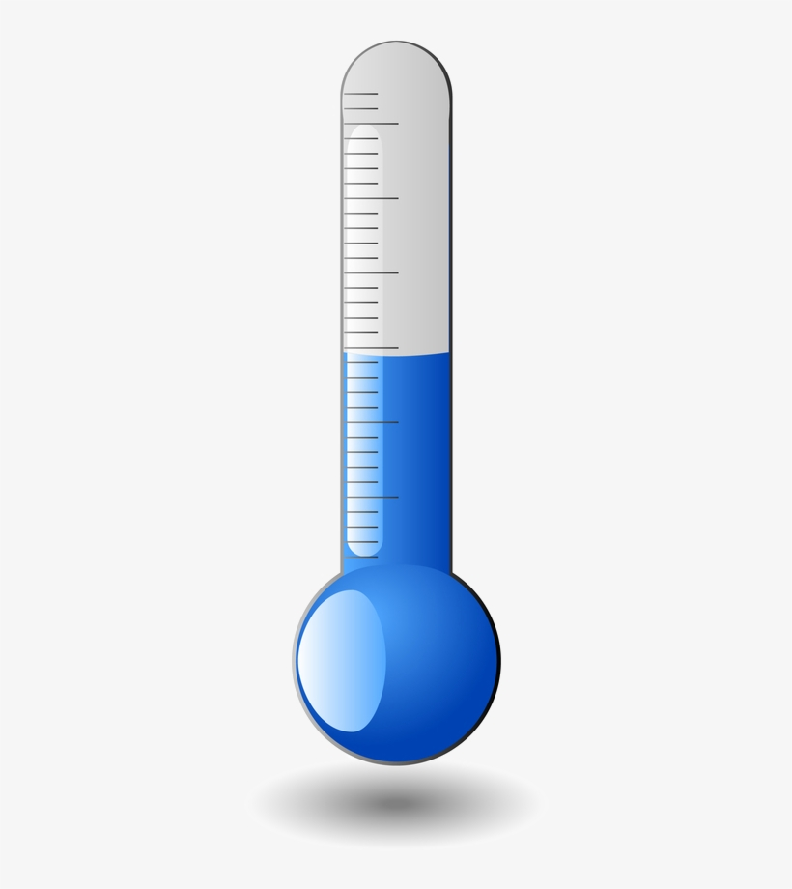
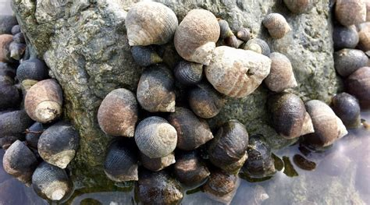
Why does Correlation ≠ Causation: Treatment Effects in a Partially Observed World
D_{i} = 1
Y_{1i}
Difference in means = ATE +
Selection Bias +
Treatment Heterogeneity Bias
D_{i} = 0
Y_{0i}

Slide 4
What Does Correlation ≠ Causation Mean?
Unmeasured Covariates
This is a Confounder – Omitting it creates Omitted Variable Bias
No, that just goes into residual error
+
-
+
Temperature
Snails

Slide 5

When are Omitted Variables a Problem?
Unmeasured Driver that is Not a Confounding Variable
Common Driver Causing Omitted Variable Bias
Common Driver Causing Omitted Variable Bias Indirectly
U
Z
U
U
X
Y
X
Y
X
Y
X
X

Slide 6
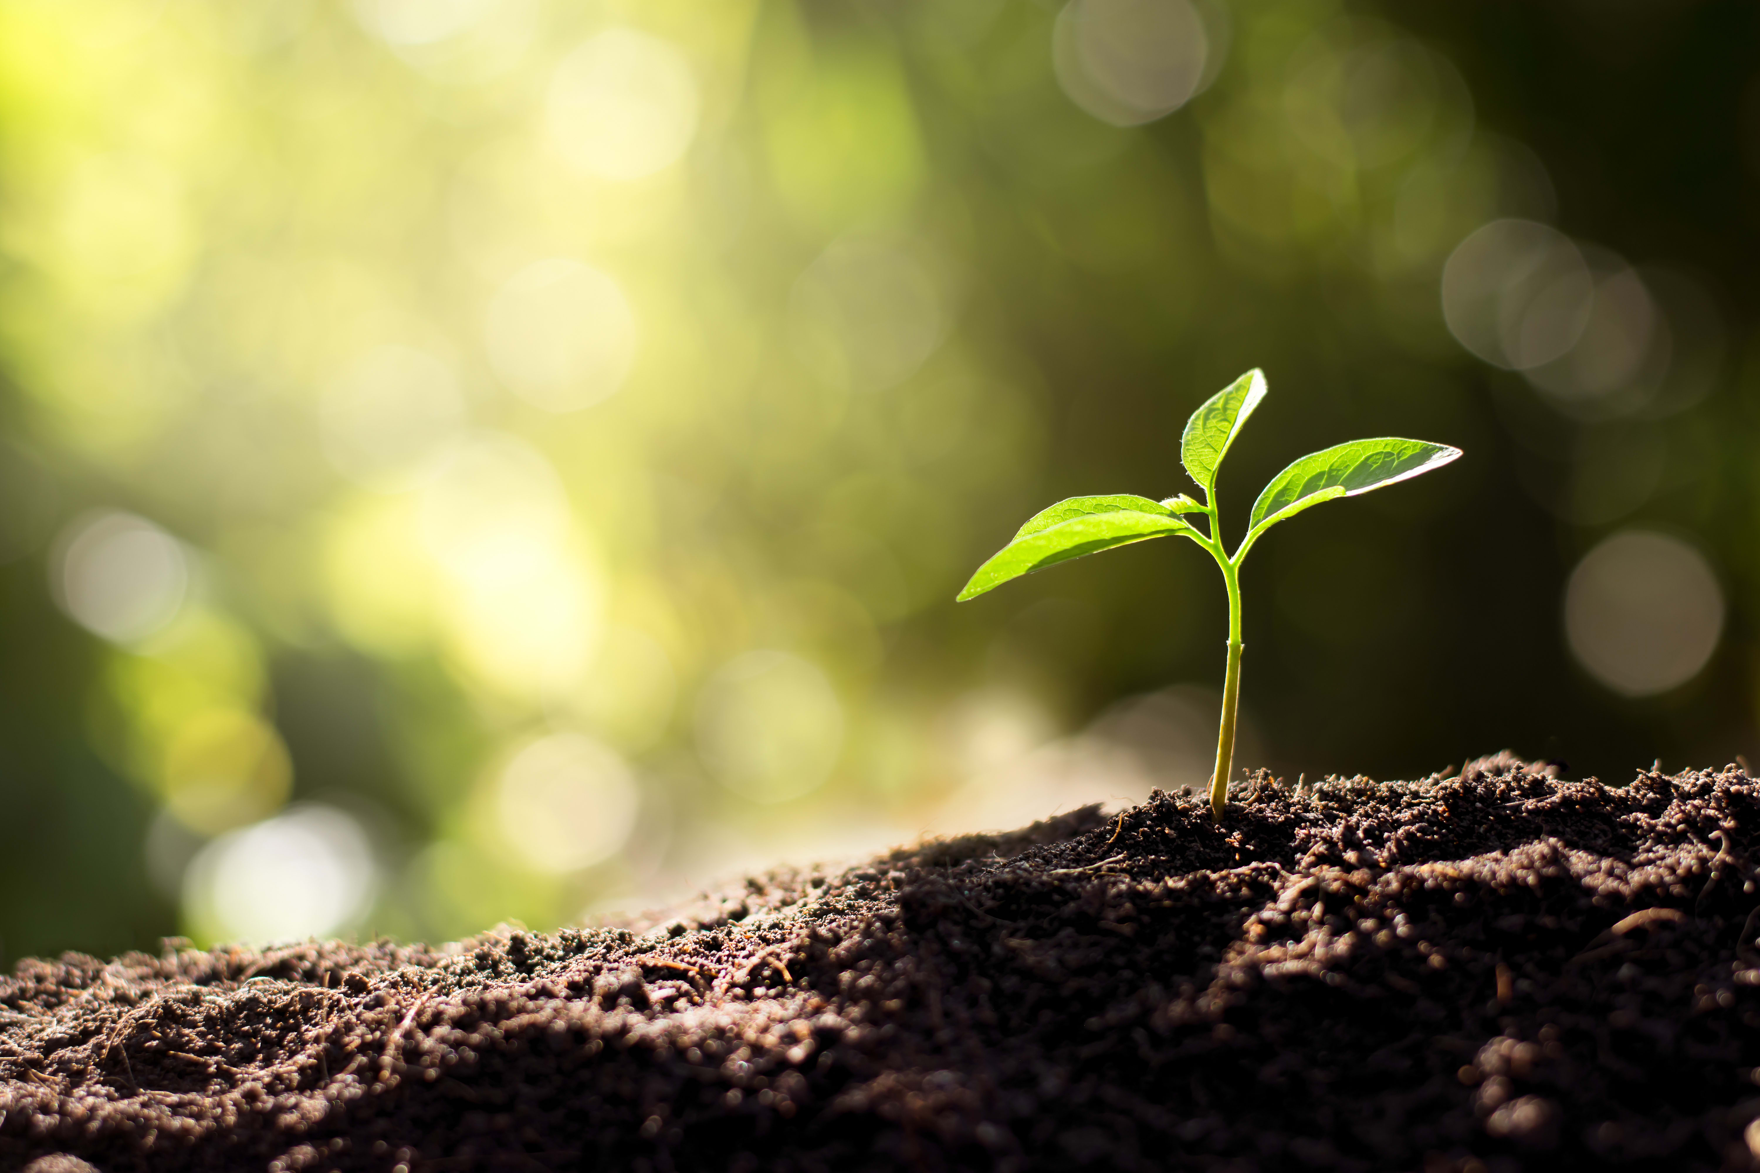
How does OVB Cause Problems?
{
Conditioning on Observables
Analysis
S
e
Your System
Modeled Results
N
G
S
-
+
What you think you are Doing with OVB
G
N
G
N
G
e
+
S = Soil Chemistry
N = Soil Nitrogen
G = Plant Growth
What you are ACTUALLY doing with OVB
N
N
G
e+S

Slide 7

Correlation does not equal causation… but where there’s smoke, there’s fire. -Jim Grace

Slide 8
Making Causal Conclusions from Observational Data
Sampling to Avoid Bias
Selecting Variables for Analysis and Avoiding the Causal Salad
Using Clustering to Avoid Confounding
Hierarchical sample Designs
Causal analysis for cross-sectional and panel designs

Slide 9
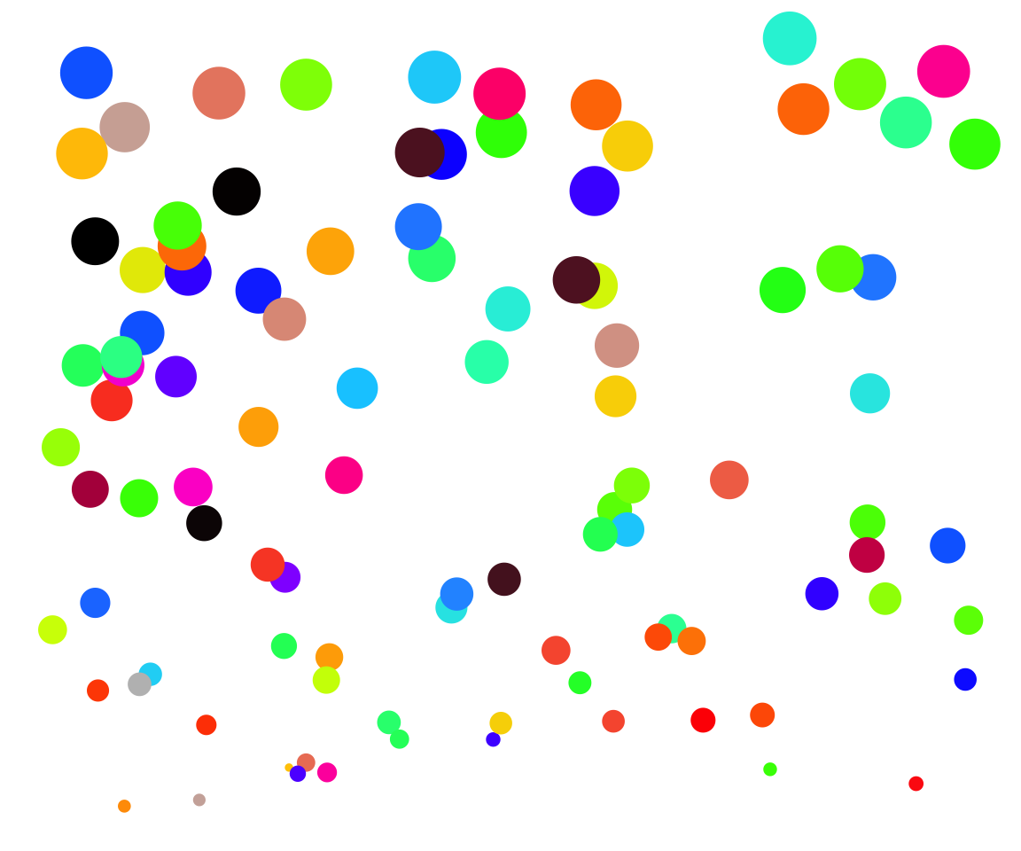
A Return to Balls of Different Colors and Sizes

Slide 10
What we Want to Know
Color
Size

Slide 11
But… How Could This be a Problem?
Color
Size
Location

Slide 12
Sample Bias
If we only sample at the top, small variation in size can remove ability to detect a color signal
Color
Size
Location

Slide 13
A Backdoor?
If location influences color, we have an open backdoor that either needs to be modeled or sampling design needs to decouple them
Color
Size
Location

Slide 14
Collider Bias
Large balls are likely at the top OR of a certain color
By chance less likely to be both at the top AND of a certain color
Color
Size
Location

Slide 15
A Collision of Sampling and Regression
Consider the following:
You are interested to see if academic ability and athletic ability are correlated. So, you sample students at your university.
Athletic Ability
Academic Ability

Slide 16
A Collision of Sampling and Regression
But how do you get into college?
Academic Ability
College
Admit
Athletic
Ability
Athletic Ability
Academic Ability

Slide 17
The Collider
Causal Model
Cause 1
Effect
Cause 2
What it would do to Multiple Regression
Cause 1
Conditions on effect, opening path between causes
Creates spurious correlations
Cause 2
Effect

Slide 18
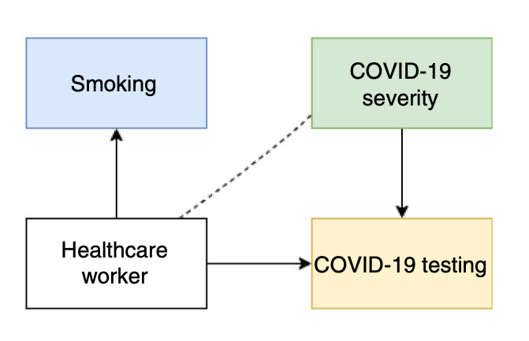
Surely We Wouldn’t Fall Prey To Collider Bias…
Preliminary studies suggested that
a) Healthcare workers were likely to get less severe Covid infections
b) Covid infection was lower among smokers
WHY?
-
+
+
Griffith et al. 2020 Nat. Com.

Slide 19
The Real Problem is When You Don’t Know About the Location Effect
Color
Size
Location

Slide 20
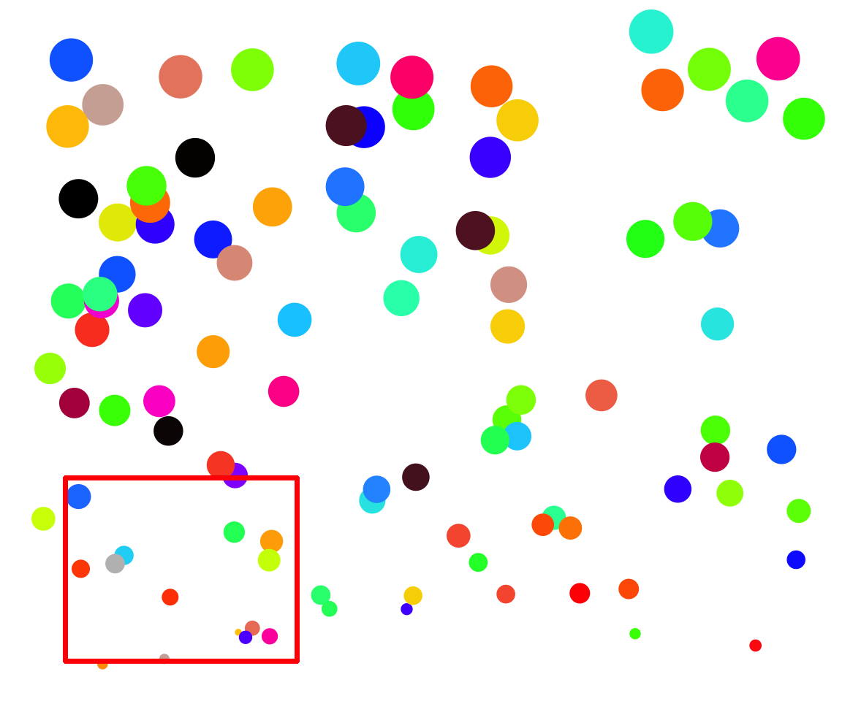
Sampling to Overcome Bias and Backdoors
NO

Slide 21
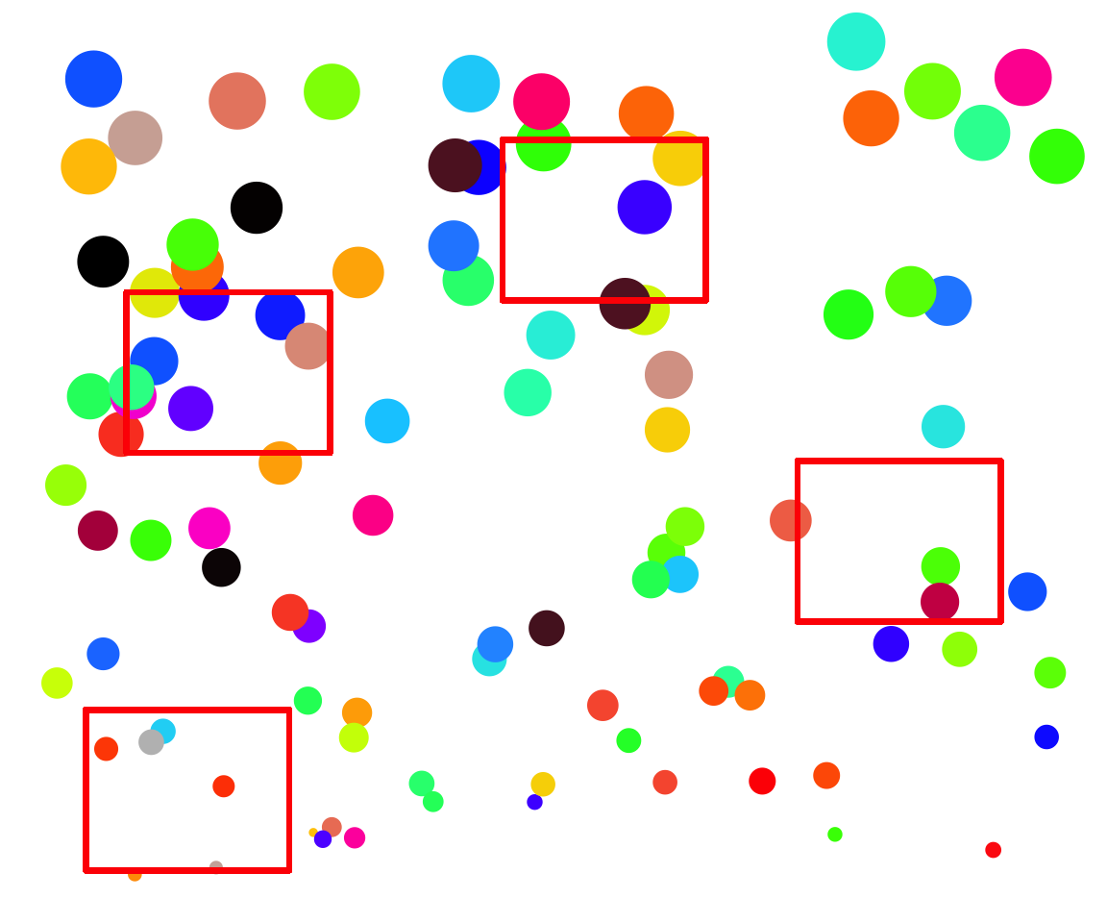
Randomized Sampling Design
Attempts to replicate experiments
Remove selection bias via randomizing over location
random.org is your friend

Slide 22
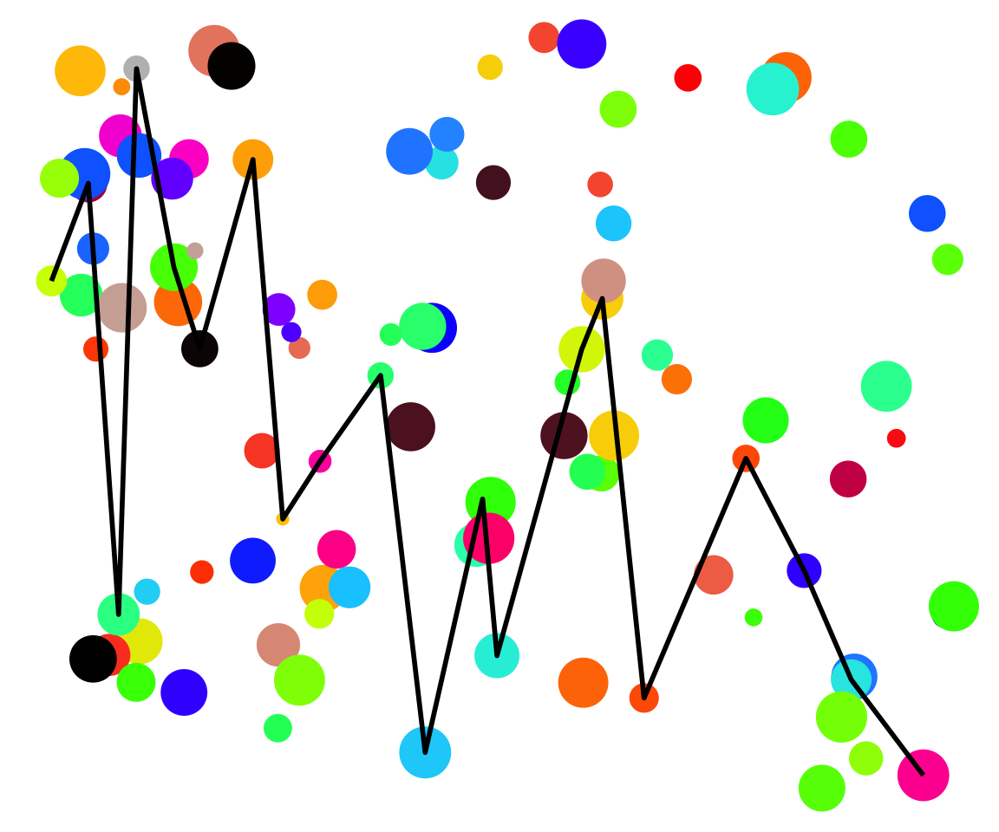
Randomized Sampling Design
Attempts to replicate experiments
Remove selection bias via randomizing over location

Slide 23
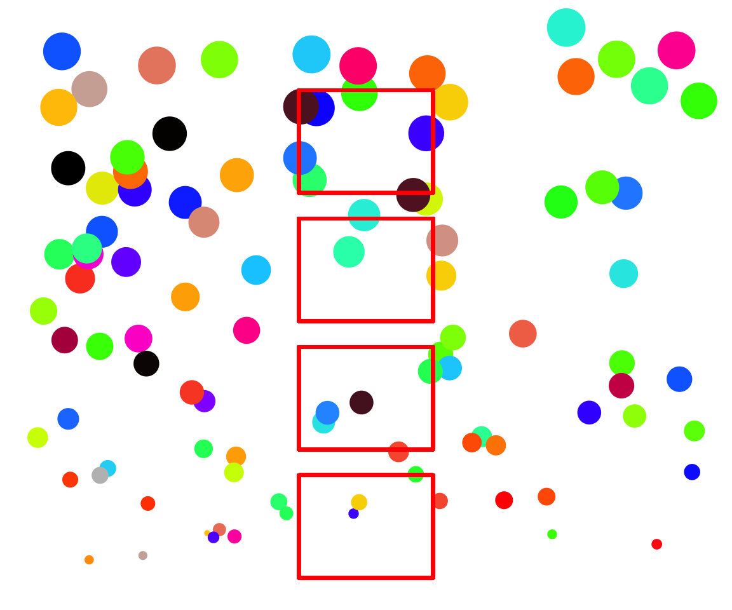
Stratified Sampling Design
Attempts to replicate factorial experiments
Remove selection bias via averaging over location

Slide 24
Stratified Random Sampling Design
Randomize within strata
Strata 1
Strata 2
Strata 3

Slide 25
Many Forms of SRDs
Random position on height
Walk across length gradient

Slide 26
Sampling and Selection Bias
Observational sampling seeks to remove sources of selection bias
Some may be backdoors, but others are simply collider bias
The concepts – randomization – are infinitely relevant
Space, time, subjects, age, etc. etc. etc.

Slide 27
Making Causal Conclusions from Observational Data
Sampling to Avoid Bias
Selecting Variables for Analysis and Avoiding the Causal Salad
Using Clustering to Avoid Confounding
Hierarchical sample Designs
Causal analysis for cross-sectional and panel designs

Slide 28
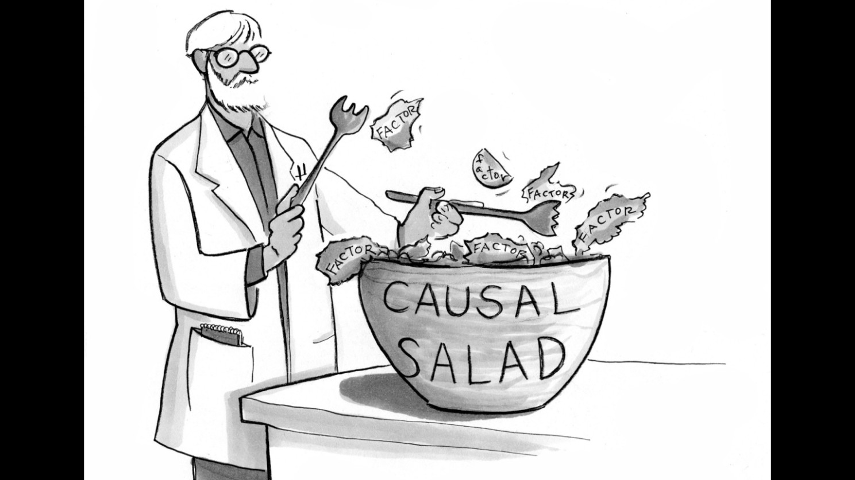
A Researcher Without a DAG Building a Model
Julia Suits

Slide 29
Features of DAGs to Watch Out For in Selecting Predictors
The Collider
The Chain
X1
X2
X1
X2
Y
Y
The Descendant
The Fork
X2
X1
X2
Y
X3
X1
Y

Slide 30
Chain of Foolish Inference
Consider the following:
You are following a cohort of patients with tumors to see if tumor size influences buildup of blood toxins. You measure differences in tumor sizes at t0, and then again at t1, when you take blood samples
Which tumor size(s) do you use as predictors of blood toxin concentrations? Initial, final, or both?
Initial Tumor
Final
Tumor
Toxin
Concentration

Slide 31
Consider the Consequences
Truth
Final
Tumor
Toxin
Concentration
Initial Tumor
Regression 1
Toxin
Concentration
Initial Tumor
Net effect, ignoring mediator
Regression 2
Initial Tumor
What does this mean?
Toxin
Concentration
Adjust effects
holding mediator
or initial constant
Final
Tumor
What does this mean?

Slide 32
The Chain
Causal Model
In experiments, this is controlling for post-treatment effects
Cause
Mediator
Effect
What it can do to Multiple Regression
Mediator blocks cause
Looks like no or opposite link between cause and effect
Can be OK if you are also analyzing the cause -> mediator relationship
Cause
Effect
Mediator

Slide 33
Will a Child Set us Free?
Consider the following:
What if we knew the final tumor was shedding cells, and we had their concentration. Should we control for that?
Initial Tumor
Final
Tumor
Toxin
Concentration
Shed
Cells

Slide 34
The Descendant Problem
Causal Model
Cause
Mediator
Effect
Descendant
What it would do to Multiple Regression
Cause
Descendant still partially blocks cause
Masks effect of cause – many possibilities
Effect
Descendant

Slide 35
The Fork
Exogenous Cause
Causal Model
Cause
Effect
What it would do to Multiple Regression
Cause
Nothing – this is great!
The core of causal inference from regression!
Effect
Exogenous
Cause

Slide 36
The Bigger Problem…
Exogenous Cause
Causal Model
Cause
Effect
Univariate Regression
Cause
Effect
The relationship is contaminated – results unreliable!

Slide 37
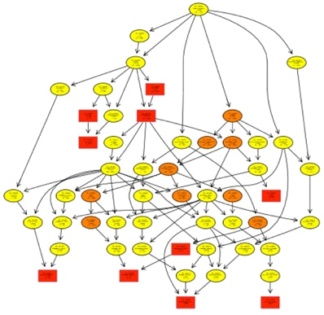
Choosing Variables for a Model
DAGs show direct connections to a response variable
They also show other variables indirectly connected – which might be the ones you have measured!
Choosing which variables to use to clean up the signal of your analysis is dangerous waters
Use your DAG to avoid improper conditioning

Slide 38
Making Causal Conclusions from Observational Data
Sampling to Avoid Bias
Selecting Variables for Analysis and Avoiding the Causal Salad
Using Clustering to Avoid Confounding
Hierarchical sample Designs
Causal analysis for cross-sectional and panel designs

Slide 39
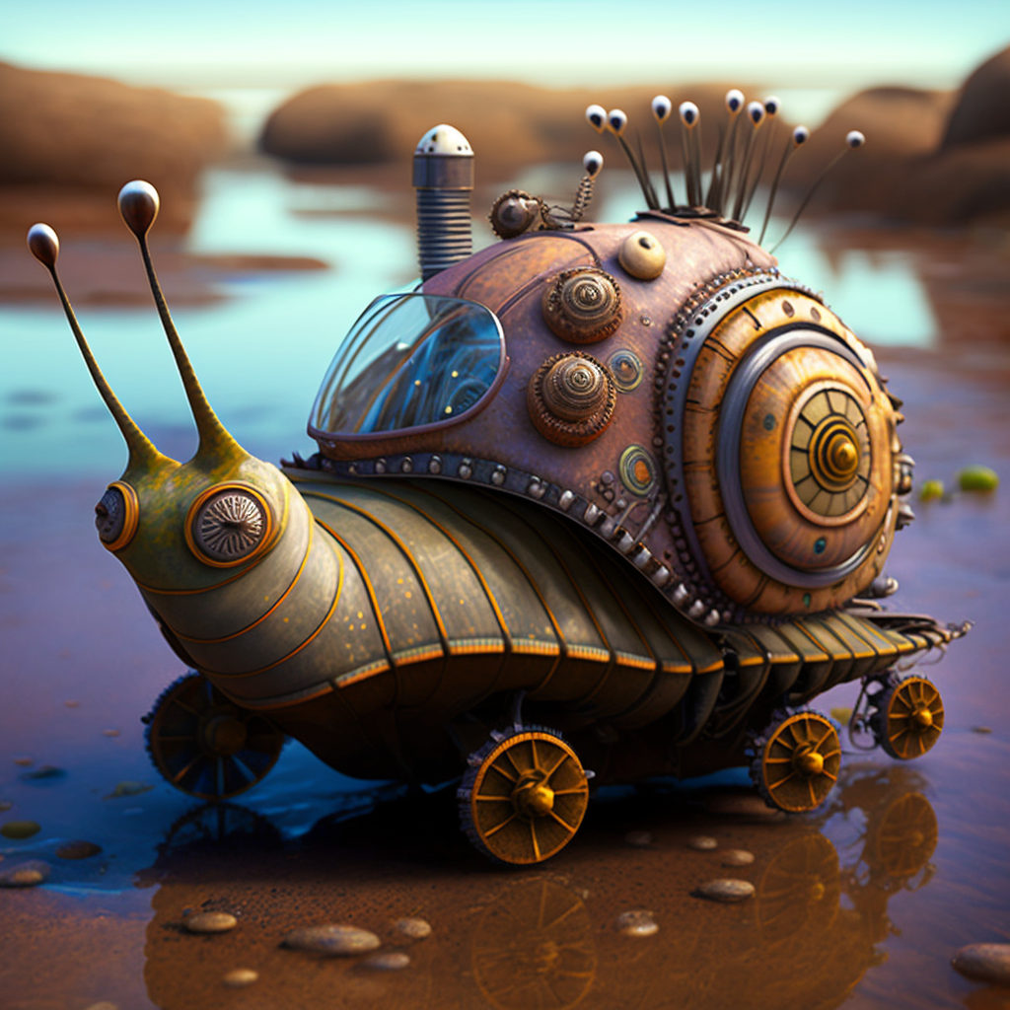
Your Question: How is temperature affecting the abundance of these snails?
Temperature
Snails

Slide 40
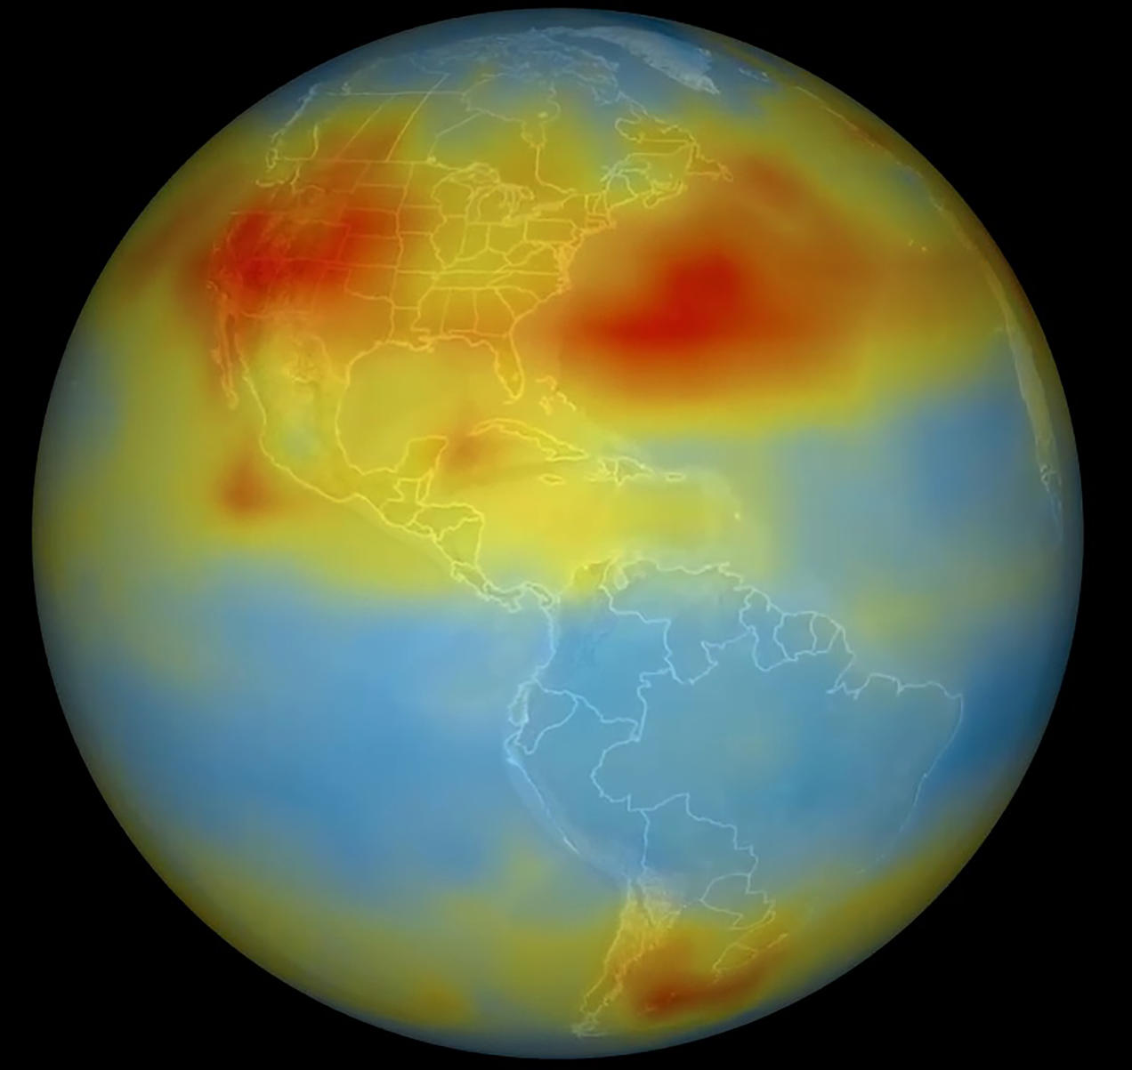
Temperature
Recruitment
© NRDC

Slide 41
Why Is This Study a Bad Idea?
Unmeasured Covariates
This is a Confounder – Omitting it creates Omitted Variable Bias
No, that just goes into residual error
+
-
+
Temperature
Snails

Slide 42
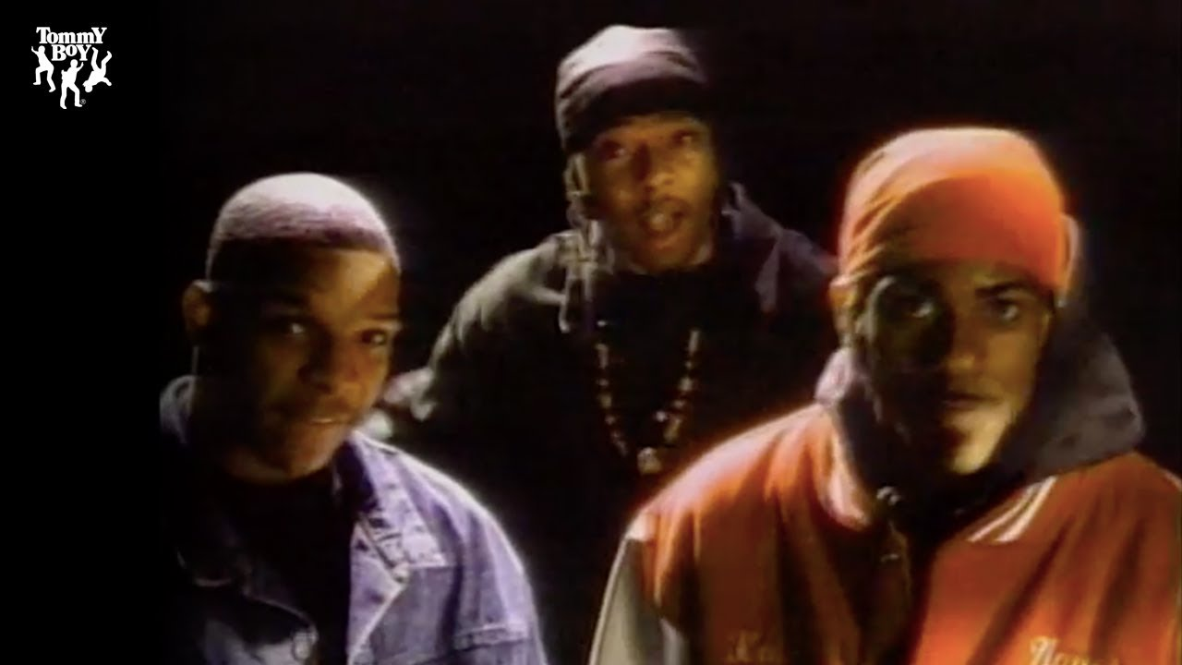
You down with OVB?
Yeah, you know me!

Slide 43
Our Snail Story as a Causal Directed Acyclic Graph – with a Solution!
Recruitment
Oceanography
Temperature
Snails
Other Things Driving Temperature
See Arif and MacNeil 2022 Eco. Mono. and dagitty

Slide 44
Design Solution: Leverage the Fact that Confounders work at a Cluster Level, Other Things at a Replicate Level
Recruitment
Oceanography
Temperature
Snails
Other Things Driving Temperature

Slide 45
We Can Cope if We Have Different Hierarchies of Variation in our Studies
Site is Cold, has High Recruitment
Site is Warm, has Low Recruitment
Plots are COLD, but
Vary in temperature
Plots are WARM, but
Vary in temperature

Slide 46
Hierarchical/Clustered Cross-Sectional Designs for Coping with OVB using Space
.
.
.
.
.
.
.
.
.
.
.
Each plot within a site has a different temperature
Each site receives a different level of recruitment
.
.
.
.
.
.
.
.
.
.
.
.
.
.
.
.
.
.
.
.
.
.
.
.
.

Slide 47
Panel Designs for Coping with OVB using Time
Time 1
Time 2
Time 3
Time 4
.
.
.
.
.
.
.
.
.
.
.
.
.
.
.
.
.
.
.
.
.
.
.
.
.
.
.
.
.
.
.
.
.
.
.
.
.
.
.
.
.
.
.
.
.
.
.
.
Temperature varies through time, sites sampled repeatedly
Each site has a different level of recruitment that is constant

Slide 48
Making Causal Conclusions from Observational Data
Sampling to Avoid Bias
Selecting Variables for Analysis and Avoiding the Causal Salad
Using Clustering to Avoid Confounding
Hierarchical sample Designs
Causal analysis for cross-sectional and panel designs

Slide 49
Your Question: How is temperature affecting the abundance of these snails?
Temperature
Snails

Slide 50
Random Effects Are Problematic
Non-Site Error
Violates Assumption of Independence of Error and Fixed Effects
Endogeneity problem!
Site
Error
Temperature
Snails

Slide 51
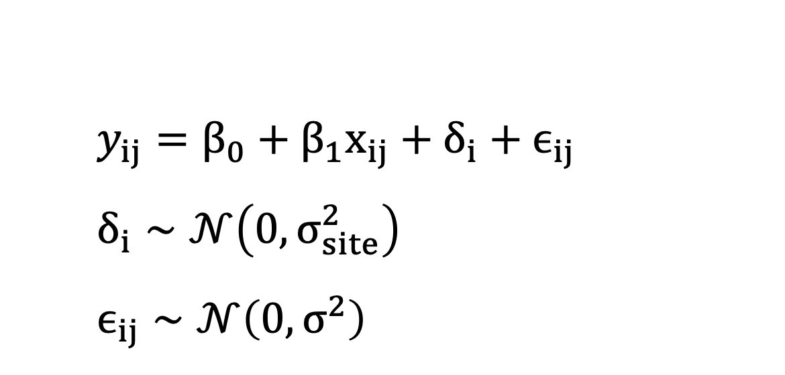
We Can See Where the Problem Arises
$$y_{ij}=β_{0}+β_{1}x_{ij}+δ_{i}+ϵ_{ij} \\ δ_{i}∼𝒩\left(0,σ_{site}^{2}\right) \\ ϵ_{ij}∼𝒩\left(0,σ^{2}\right)$$
Our effect of interest
We are estimating
From a distribution
i = site/time
j = replicate

Slide 52
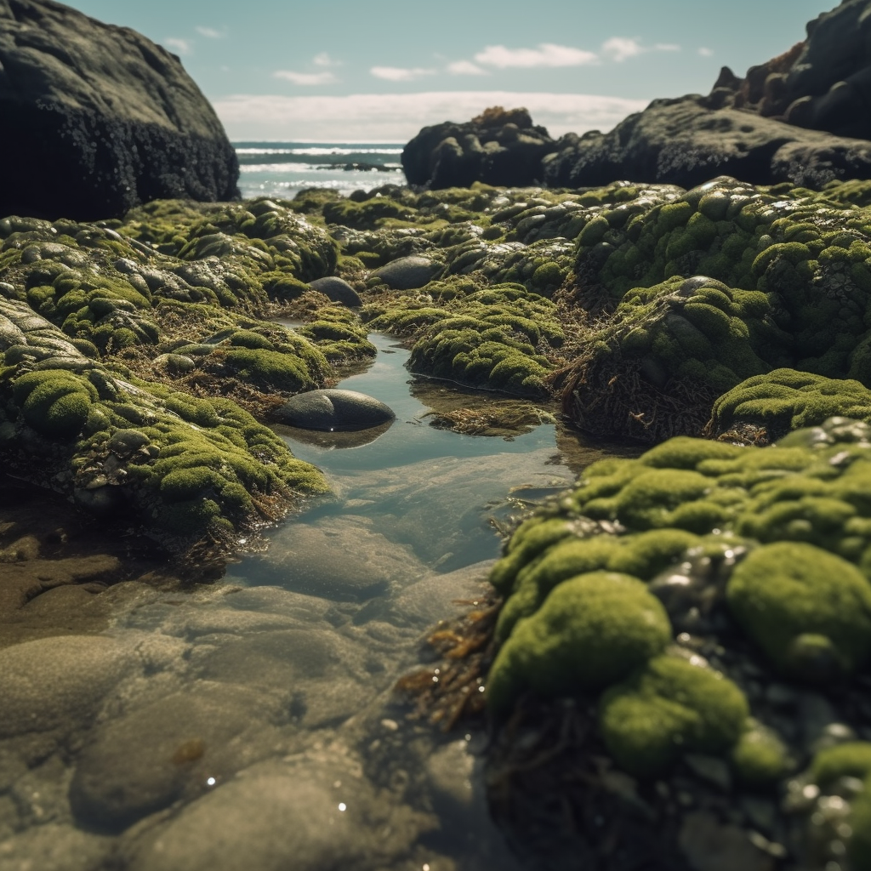
Throw Out Site: Fixed Effect Transformation
Estimates Temperature Effect Controlling for Site
BUT – will need corrected SE
And cannot study between site effects
Error
$$y_{ij}−\overline{y_{i}}=β_{1}\left(x_{ij}−\overline{x_{i}}\right)+\left(ϵ_{ij}−\overline{ϵ_{i}}\right)+(u_{i}−\overline{u_{i}}\text{)}$$
Deviation from Site Mean Temperature
Deviation from Site Mean Snail Abundance

Slide 53
Hello Fixed (Categorical) Effects My Old Friend...
Estimates Temperature Effect Controlling for Site
BUT – can have high cost in Degrees of Freedom
And cannot study between site effects
Error
Site
Temperature
Snails

Slide 54
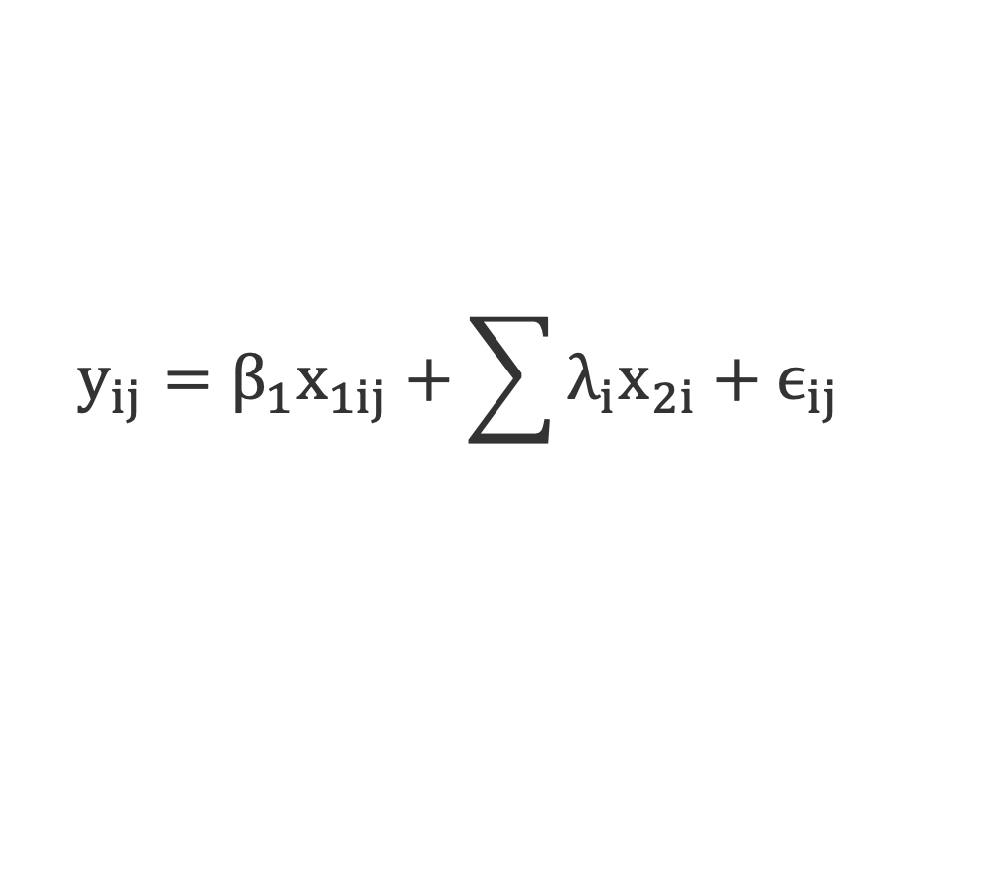
Fixed Effects are Dummies
X_{2i} is 0 or 1 depending on if replicate
is in a given cluster
Our effect of interest
$$y_{ij}=β_{1}x_{1ij}+\sum{λ_{i}x_{2i}}+ϵ_{ij}$$
i = site/time
j = replicate

Slide 55
Reducing DF By Decomposing Temperature
Oceanography
Recruitment
Proxy for Site-Level
Omitted Variables
Site Mean Temperature
Other Things Driving Temperature
Site Temperature
In Year T
Snails

Slide 56
Group Mean Covariates: The Mundlak Device
Site
Error
Estimates effect of temperature WITHOUT covarying drivers at Site level
Site mean temperature represents between Site variation from other drivers
Calculate temperature anomaly from site if collinearity high
Site Mean
Temperature
Snails
Site Temperature
In Year T

Slide 57
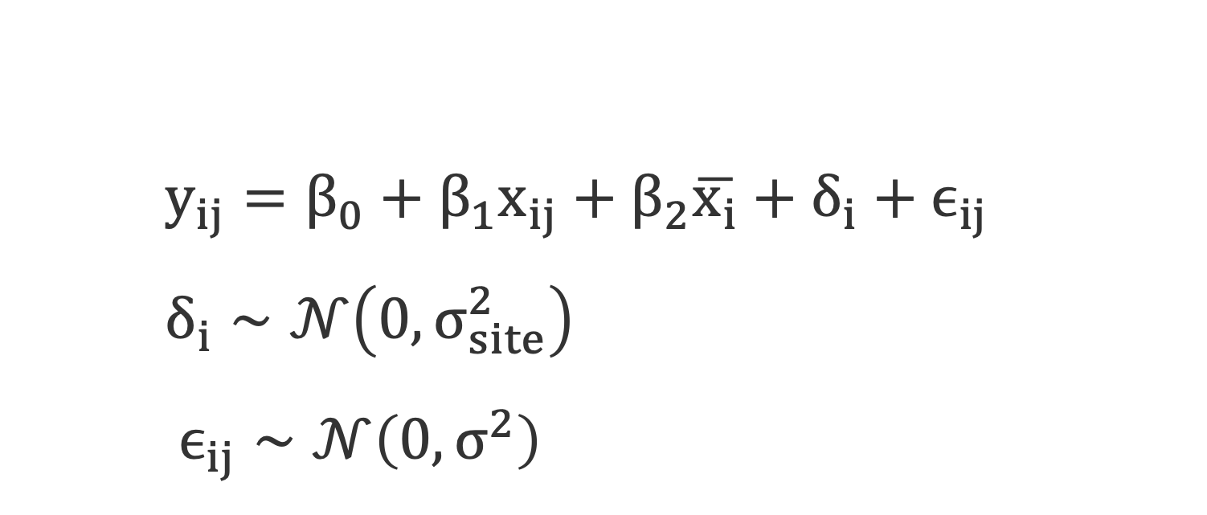
Mundlak Device: Simpler Than you Think!
Our effect of interest
Cluster Average Effect
$$y_{ij}=β_{0}+β_{1}x_{ij}+β_{2}\overline{x_{i}}+δ_{i}+ϵ_{ij} \\ δ_{i}∼𝒩\left(0,σ_{site}^{2}\right) \\ ϵ_{ij}∼𝒩\left(0,σ^{2}\right)$$
Woooo random effects of everything else!!!

Slide 58
Group Mean Centering: An Anomalous Solution to Collinearity
Site
Error
Site Mean
Temperature
Snails
0
Estimates effect of temperature WITHOUT covarying drivers at Site level
Site mean temperature represents between Site variation from temperature and other drivers
Temperature
Anomaly in Year T
Model Type | Temp Estimate | SE
RE | 0.43 | 0.22
Group Mean Centered | 1.01 | 0.30

Slide 59
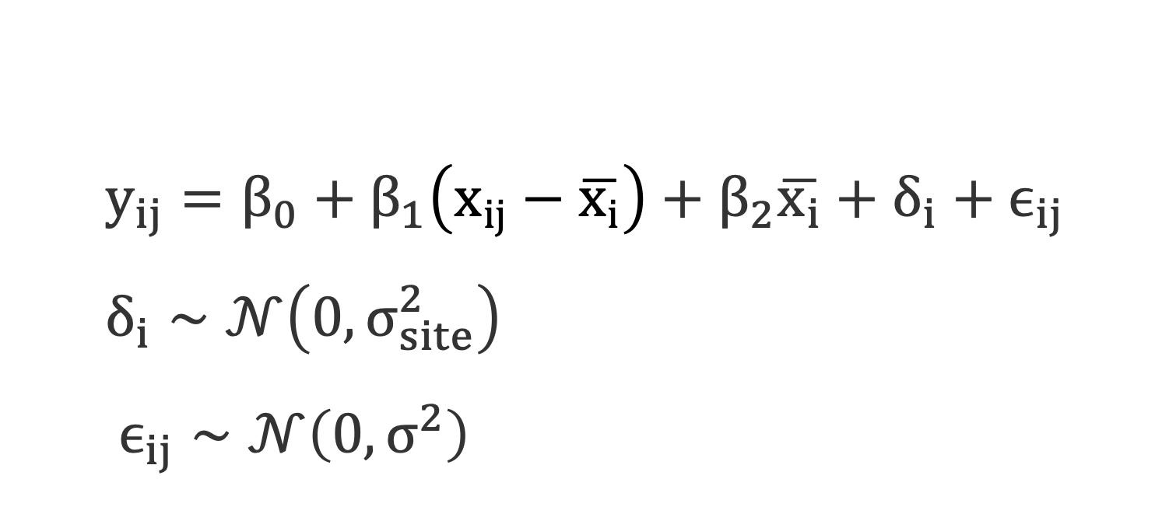
Group Mean Centering Uses Anomalies
Anomaly from Cluster
Our effect of interest
Cluster Average Effect
$$y_{ij}=β_{0}+β_{1}\left(x_{ij}−\overline{x_{i}}\right)+β_{2}\overline{x_{i}}+δ_{i}+ϵ_{ij} \\ δ_{i}∼𝒩\left(0,σ_{site}^{2}\right) \\ ϵ_{ij}∼𝒩\left(0,σ^{2}\right)$$
Woooo random effects of everything else!!!

Slide 60
What if There is a Temporally Correlated Driver?
Recruitment
Oceanography
Snails
Temperature
Local Temperature Drivers
Local Coastal Development
Time

Slide 61
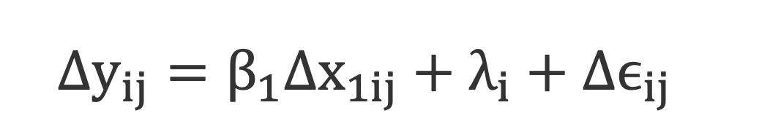
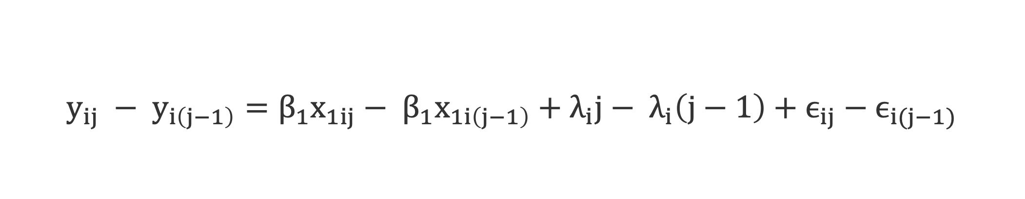
A Little Differencing Algebra
$$y_{ij} − y_{i\left(j−1\right)}=β_{1}x_{1ij}− β_{1}x_{1i\left(j−1\right)}+λ_{i}j− λ_{i}\left(j−1\right)+ϵ_{ij}−ϵ_{i(j−1)}$$
$Δy_{ij}=β_{1}Δx_{1ij}+λ_{i}+Δϵ_{ij}$
Our effect of interest
Slope of Site Counfounder

Slide 62
Differencing for Repeated Measures for Temporal Repeated Measures (Panel) Designs
Error
Change in
Temperature
Change in
Snails
Model Type | Temp Estimate | SE
RE | 0.43 | 0.22
First Differences | 1.03 | 0.27
Site
Site is the slope of other site-level changes

Slide 63

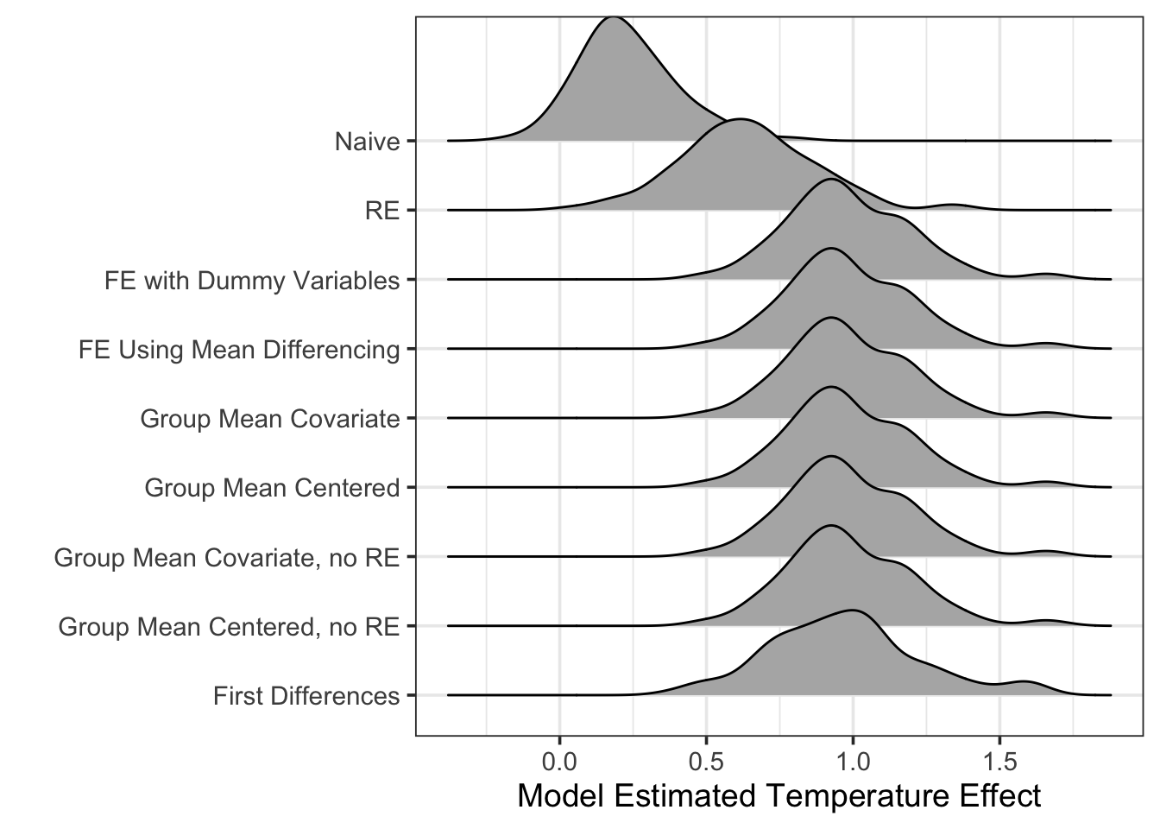
Causal Methods are Unbiased and Accurate
https://shiny.umb.edu/shiny/users/jarrett.byrnes/ovb_sims/

Slide 64
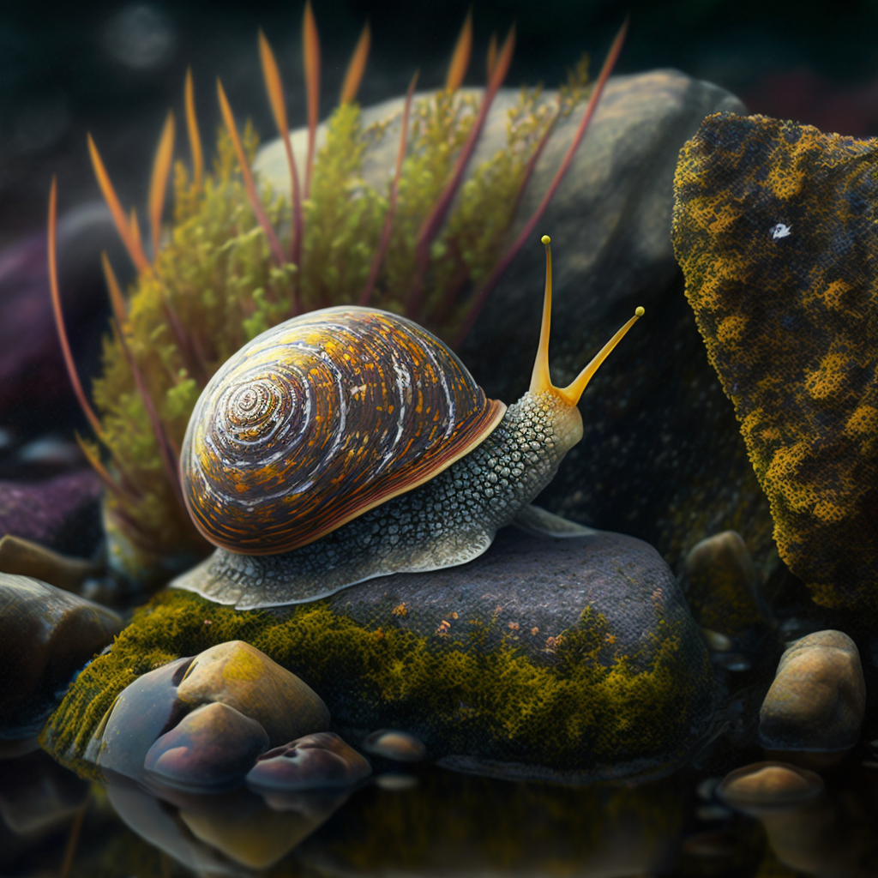
Does It Blend: Some Snail Simulations
Sample 10 sites for 10 years using Panel sampling design
Oceanography has opposing effects on temperature and recruitment
Interannual variation in temperature, but not recruitment
Both temperature and recruitment have a 1:1 relationship with abundance
https://shiny.umb.edu/shiny/users/jarrett.byrnes/shiny_ovb/

Slide 65
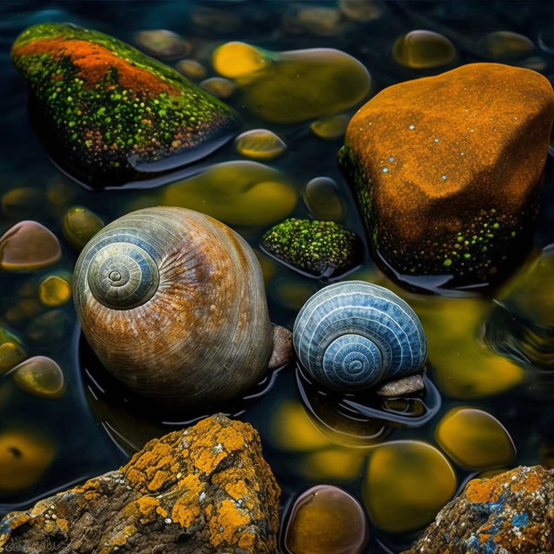
Causal Methods Have Better Power & Accuracy
Model Type | 95% CI Contains 0 | 95% CI does Not Contain 1
RE | 0.08 | 0.54
FE with Dummy Variables | 0.00 | 0.05
FE Using Mean Differencing | 0.00 | 0.05
Group Mean Covariate | 0.00 | 0.05
Group Mean Centered | 0.00 | 0.05
First Differences | 0.01 | 0.04
https://shiny.umb.edu/shiny/users/jarrett.byrnes/ovb_sims/

Slide 66
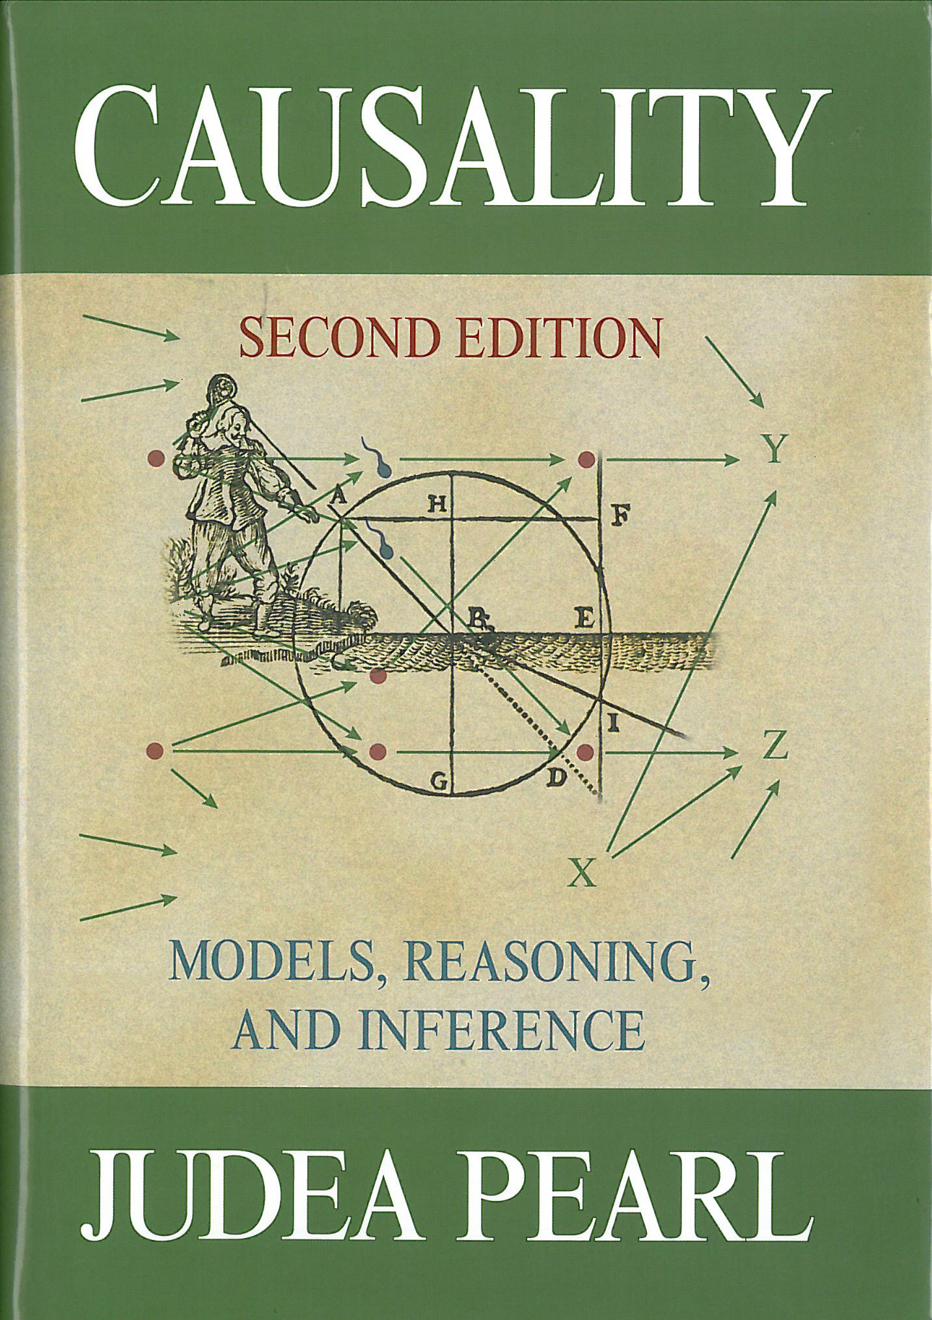
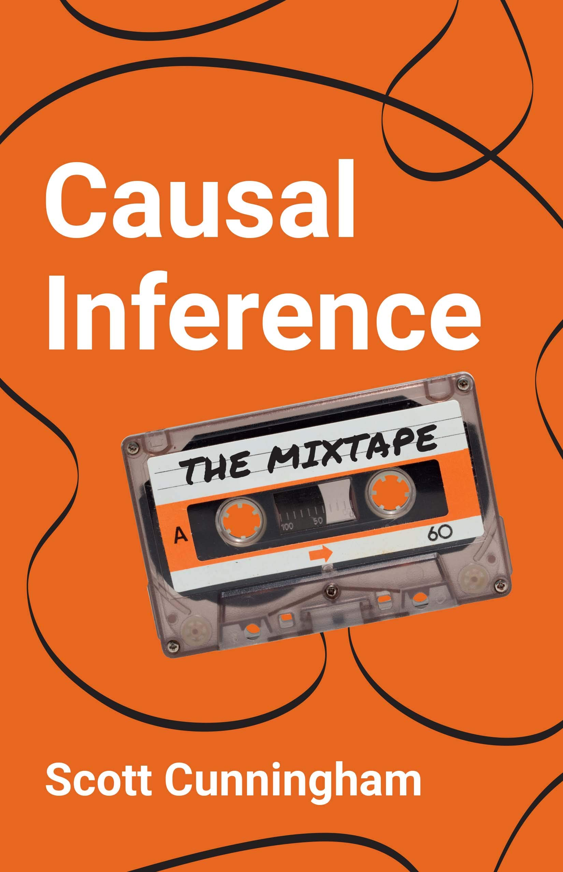
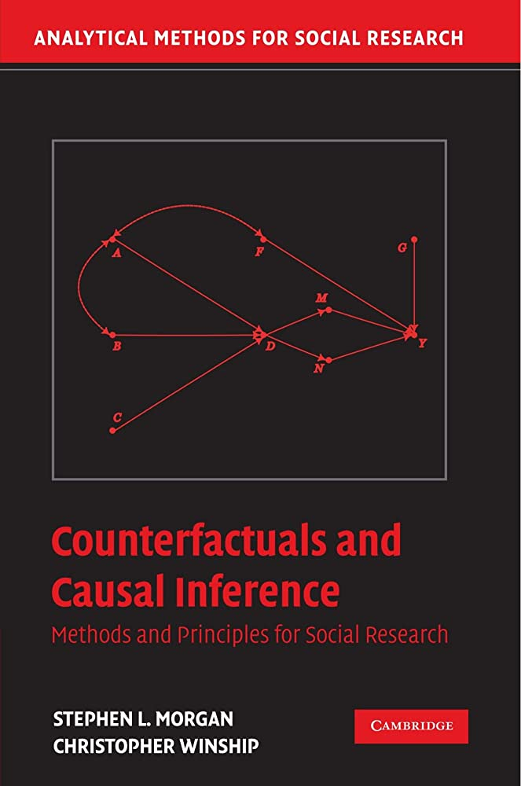
Coping with OVB
Read More (what, you thought I covered everything here?)
Draw your system – all of it
Sample appropriately (if possible)
Use a statistical model design that is causally robust to you not measuring things
u
x
y
Error
Site
Temperature
Snails

